Slide 1
Credit and Loan Analysis
CMHDR Bank
Group 4:
Cindy Duong, Mary Shintaku, Hetal Prajapati,
Daniel Cabrera, Ray Lucero

Slide 2
Hello and welcome to CMHDR Bank
We are a group of analysts tasked with reviewing the credit and loan data for our bank. Our goals of this review are as follows:
Creating a machine learning model that will predict whether a client’s credit information is good, standard or bad and analyzing their credit behaviour.
Reviewing the customer loan data for defaults based on specific features related to their demographics, education, payment history, annual income data, etc.
Notes:
The goal of this analysis is the help the bank decide whether customers are viable options for potential loans given their credit history. As well as review the current loan data to see how different variables affect borrowers. The model that we used is helping us to analyze the customers credit information and make an accurate assessment of the risk associated with each customer. The model is also helping with the loan data in analyzing the client’s loan application, we are looking for defaults or not based on specific features related to different demographics, level of education, payment history, and annual income data to name a few. We will also be showcasing some of the results we found through the use of Tableau visualizations.

Slide 3
Intro: Why it's important to Banks
01
02
03
Credit:
Credit is an important factor when banks are looking to offer a loan.
Banks will review the credit score, credit report, payment history and credit utilization.
Loans:
Alongside credit, banks use many other factors to help determine loan eligibility.
Some of those include: Income, Employment History, DTI, Savings & Assets, and even age and loan terms.
2008 Housing Crisis:
Was caused by poor management of loans by large banks and financial institutions. Many of the loans that were seen during this time were often filled with subprime mortgages and fico scores below 600.
Notes:
Credit Information is important for a bank to review since it contains useful information in regards to a borrowers spending and payment habits. The FICO score is also a great tool to measure all of the different factors into a useful and concise number. By being able to review the payment history, credit score, credit utilization and even the age of credit the bank can make an accurate assessment of the customer. When applying for a loan, there are other variables that banks will look at besides just credit. There’s income, employment history, Debt to Income ratio and etc. All of these factors provide more useful insight into making a final decision on a borrower's application. Lastly we wanted to briefly mention the 2008 housing crisis and recession which was caused by banks poorly managing the loans that were being done at this time, including not verifying income or even checking credit.

Slide 4
Additional Information
Language: Python Machine learning (Neural Networks via Google Colab)
Visualization Method: Tableau
Data Source:
Loan data: Yamuna Nagar (2023). Loan Default Prediction [Dataset] Kaggle: https://www.kaggle.com/datasets/nikhil1e9/loan-default
Credit Card data: Rohan Paris (2022). Credit Score Classification Kaggle: https://www.kaggle.com/datasets/parisrohan/credit-score-classification
Note: CMHDR Bank is a fictional bank that was created for project work purposes.
Notes:
We used python machine learning to break down the data, utilizing Spark due to the large dataset we had, and, for the speed Spark allows to process data.
Visualization was organized via Tableau which will be introduced later on.
For the data source, we have 2 sets of data from Kaggle.
The Loan data included roughly 255,000 rows x 18 columns consisting information such as demographics, credit scores, current loan statuses etc.
The Credit Card data has approximately 32,000 rows x 27 columns in which included basic bank details and credit-related information such as annual income, credit score, payment/investment trends, DTI, and so on.
And as mentioned earlier, CMHDR Bank is a fictional bank that was created for project work purposes.

Slide 5
Cleaning The Dataset & Utilizing Neural Networks
Dropped unnecessary columns
Converted specific data-types to integers
Removed null values
Translated string objects into readable data
Identified our label (y) column
Utilizing ‘onehotencoder’ to categorize object type columns
Train, Test, Splitting the dataset
Scaling and fitting the data to the model
Utilized a function to find the best model
Credit Card Model Parameters
Activation: tanh
First layer: 6 neurons
5 hidden layers with 2 of them having 6 neurons
The remaining layers having 1 neuron
20 epochs
Loan Default Model Parameters
Activation: relu
First Layer: 1 neuron
1 hidden layer having 1 neuron
2 epochs

Slide 6
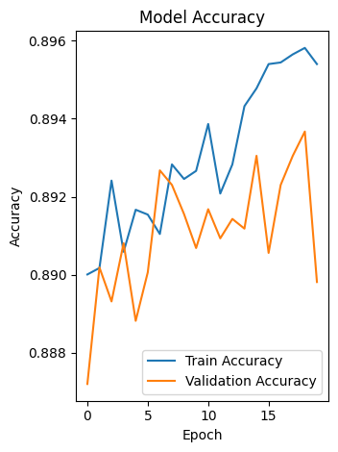
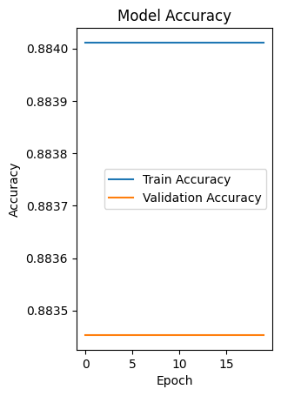
Evaluating The Results
Credit Card Model
Accuracy Score: 85.82%
Loss Score: 32.07%
Loan Default Model
Accuracy Score: 88.35%
Loss Score: 36%

Slide 7
Tableau Presentation, launching dashboard
Tableau Public Dashboard - Credit Data
Tableau Public Dashboard - Loan Data

Slide 8
Questions?

